Slide 1

IoC and DI with Ninject
1 – Dependency Inversion

Slide 2


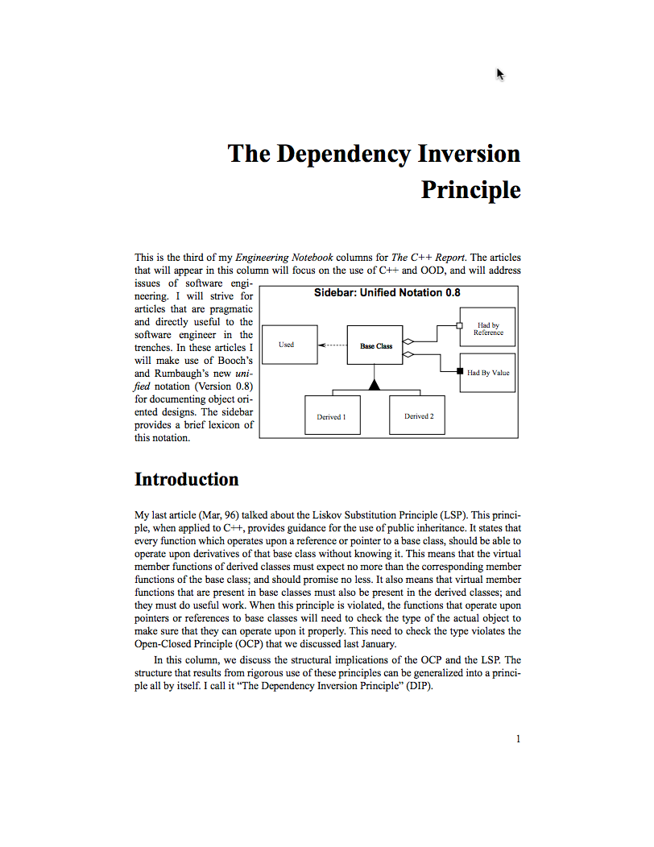
References
http://www.objectmentor.com/resources/articles/dip.pdf

Slide 3
Vocabulary
DIP: Dependency Inversion Principle
IoC: Inversion of Control
DI: Dependency Injection
IoC Container
Interfaces
Lifetime management

Slide 4
The way we were taught: Layered Software
UI
Business Logic
Data Access

Slide 5











Stop thinking of high versus low Everything is peers

Slide 6
Well, it’s really more like this
Views
GUI
UI Composites
View Models
Domain 1 Model
Data Access Model 1
Domain 2 Model
Data Access Model N
Message Bus 1
Message Bus 2

Slide 7
Many more than that…
GUIs
View Models
Models (non-data bases)
Data Model 1
Data Model 2
System 1
System N

Slide 8
Multiple environments
Dev
Test
QA
Final Acceptance
Production
DR
HA

Slide 9
Platforms
WPF
MVC
Angular
iOS
Android
WP
Wearable

Slide 10
Not to mention…
Multiple user roles
Geo-diversity
Users
Systems

Slide 11
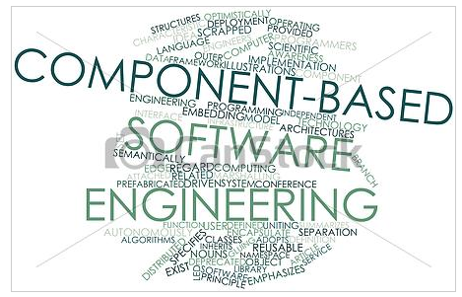
It’s component based software

Slide 12
In a nutshell, I want to…
Change UI based upon platform or user
Swap out implementations based upon environment
Allow software to adapt easily with change
Change operation based upon
Location of user
Location of the code base
Role of the user

Slide 13
Unfortunately…
Programming languages enabled software “components” … kind of … by using interfaces
But they must be in the same language (usually)
On the same machine, or process
Remember CORBA and DCOM? Ok, RMI, IIOP and Remoting for younger people?
“new” is the root of all evil
Inherently specifies an “implementation” – a “class”

Slide 14
And… still didn’t solve other problems
I need to store data, so I must:
Instantiate a database object
I must decide to use a specific type of database object

Slide 15
Dependency Inversion
Instead of lower level modules defining an interface that higher level modules depend on…
Higher level modules define an interface that lower level module implement

Slide 16
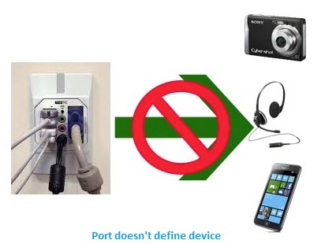
Don’t try and provide every type of connection
Instead, make devices conform to an interface
Like USB

Slide 17
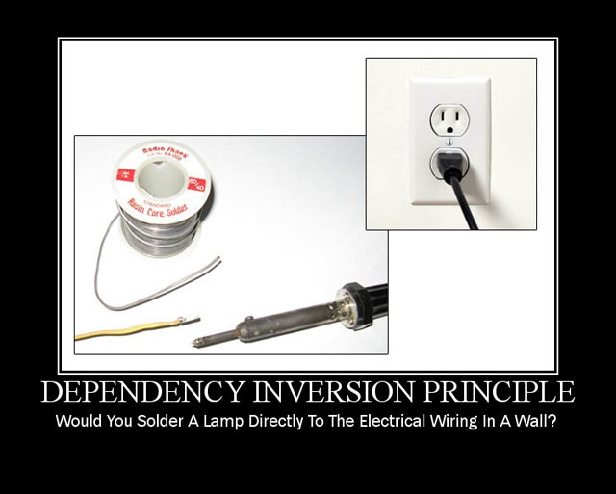

Slide 18
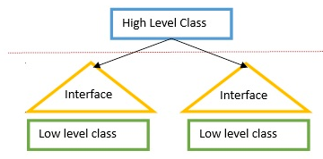
Dependency Not Inverted
Example:
If Oracle, do this, else
If SQL, do this, else
If MySQL, do this

Slide 19
Basic Tenants
High-level modules should not depend on low-level modules. Both should depend on abstractions.
Abstractions should not depend on details. Details should depend upon abstractions.

Slide 20
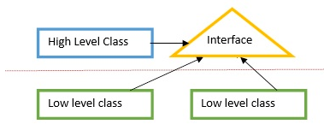
Dependency Inverted
Give me a database object with a uniform API
Who creates the object is not important to the high level class

Slide 21
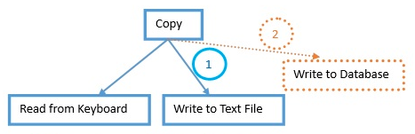
Eg: Copy not Inverted

Slide 22
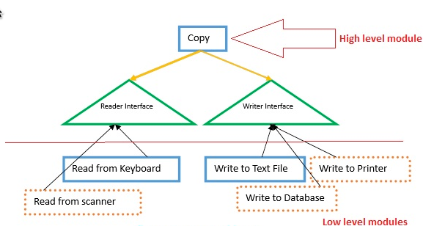
Eg: Copy Inverted

Slide 23
Net Effect
Changes in lower layers do not impact code in higher layers

Slide 24
Summary
Systems are not layered – they are component based
Components provide a capability
Capabilities are abstracted by interfaces
Where implementations are found is not known by the user
“new” is evil
Builds in dependencies
And creates directional dependencies
Any implementation can use capabilities of any other implementation
Need to decide who creates and manages specific instances and lifetimes

